Slide 1

Property Rights & Markets = Environment & Liberty
Evropský sociální fond
Praha & EU: Investujeme do vaší budoucnosti
Terry L. Anderson
Executive Director, PERC
Senior Fellow, Hoover Institution
Název projektu: Inovace studijního programu Ekonomie a hospodářská správa s akcentem na internacionalizaci výuky, individuální práce se studenty a praxi CZ.2.17/3.1.00/33332

Slide 2
PART I
Who Owns the Environment?

Slide 3
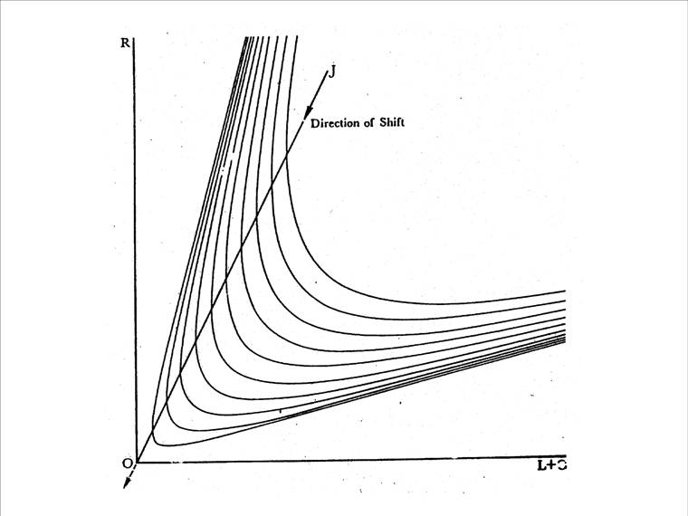

Slide 4
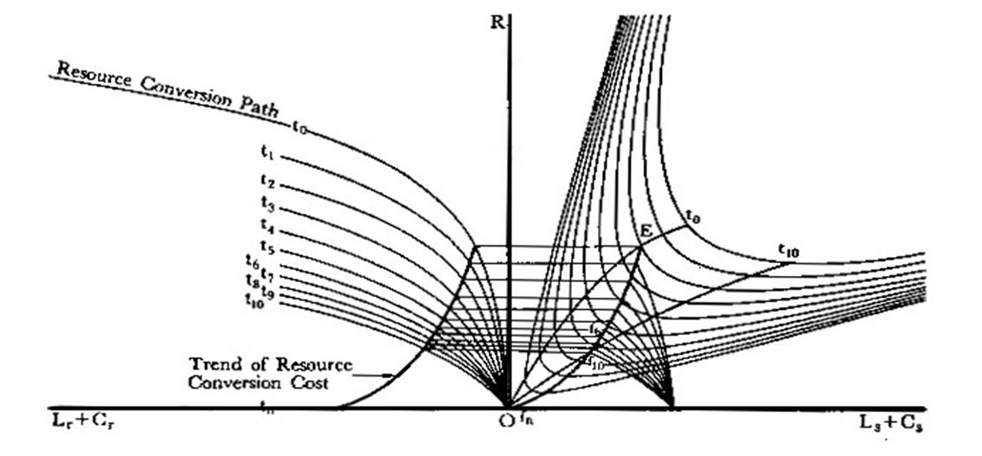

Slide 5
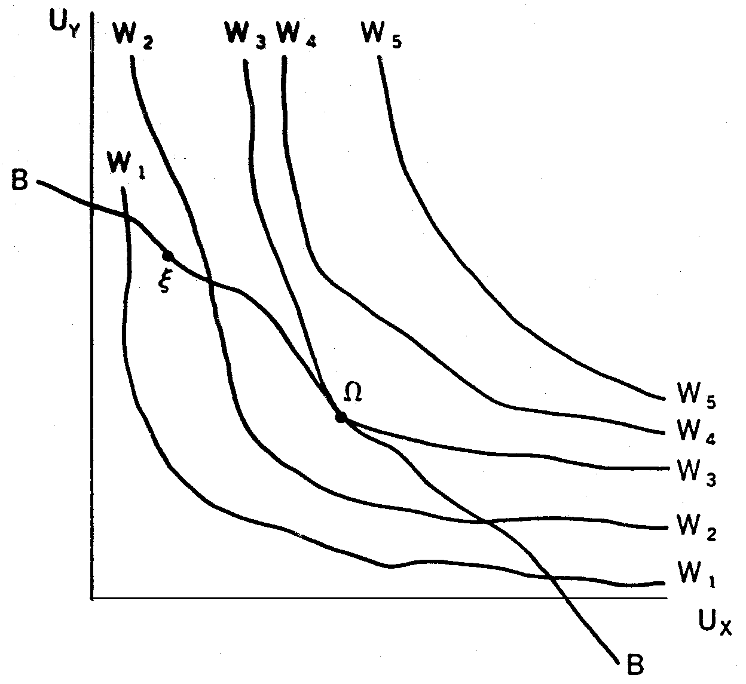
Bliss Point

Slide 6

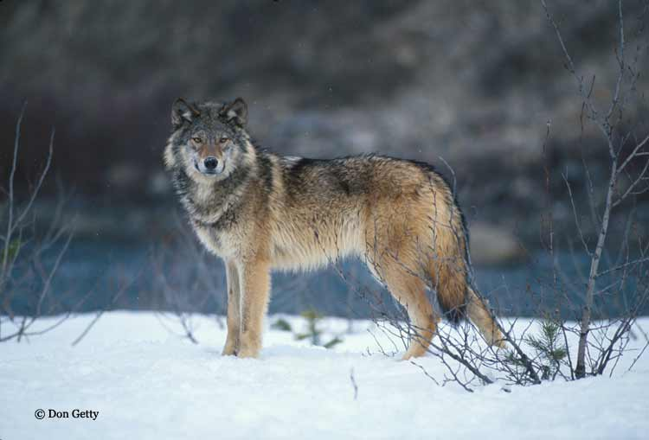
Why economists
don’t get much respect?
Value of
wolves
MC
If MB > MC, do it!
MB
Number of wolves

Slide 7
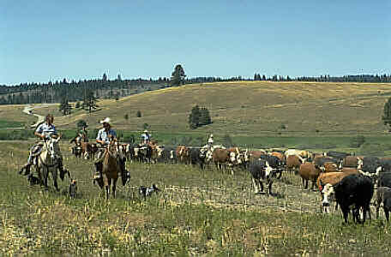
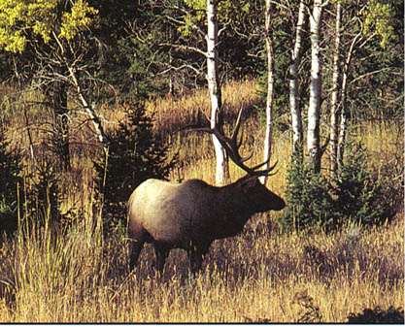
Public Choice:
MB and MC depend on the hat you wear

Slide 8
Optimal Number of Wolves--
Rancher
Value of
wolves
MC
MB
Number of wolves

Slide 9

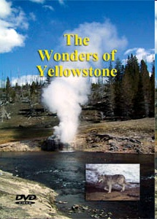

More hats

Slide 10
Optimal Number of Wolves--
NPS or Environmentalist
Value of
wolves
MC
MB
Number of wolves

Slide 11
What is the Missing Market and What is the Result?
If not all costs, we get the tragedy of the commons—too much.
  Fisheries, groundwater, air
If not all benefits, we get the free rider problem—too little.
  Endangered species, open space

Slide 12
Missing Property Rights
= Missing Markets
Are there property rights?
If not, can they be created?
If there are, can they be traded?
Or can they be weakened or taken?
What happens if they are weakened?

Slide 13
Wolfonomics
Value Cost to Import Value of
of a Wolf a Wolf Lost Sheep
1st Wolf $200 $50 $120
2nd Wolf $200 $50 $160
3rd Wolf $200 $50 $220
What is the optimal number of wolves?

Slide 14

Lessons from Coase
Scarcity generates conflicting demands.
Conflicting demands bring pressure for clarifying property rights.
With property rights, entrepreneurs make markets and create gains from trade.

Slide 16
Property Rights and Markets
--continued
Terry L. Anderson
Executive Director, PERC
Senior Fellow, Hoover Institution

Slide 17
PART II
The Evolution of Property Rights

Slide 18
Where do property rights come from?
Property rights are produced when
MB > MC

Slide 19
BENEFITS of defining & enforcing property rights
Avoidance of costs of fighting
Gains from better use
Value of the resource

Slide 20
COST of defining & enforcing property rights
Number of parties competing
Heterogeneity of the parties
Different estimates of value
Different technologies for production

Slide 21
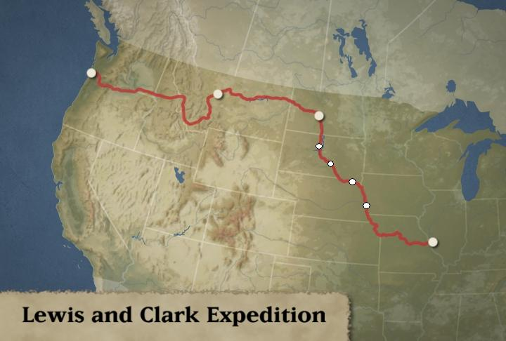
No Man’s Land:
Where the Buffalo Roam
natives and wildlife numbers are daily averages
Mandan
>10 natives
0 wildlife
Arikaras
>10 natives
2 wildlife
War Buffer
0 natives
36 wildlife
Teton Sioux
>10 natives
2 wildlife
Six-Sided
War Buffer
< 5 natives
>35 wildlife
Peace Buffer
1 native
5 wildlife
Yankton Sioux
>10 natives
1 wildlife
War Buffer
0 natives
42 wildlife
Omaha/Ottes
>10 natives
0 wildlife
War Buffer
0 natives
13 wildlife
Source: Kay, C. E. 2008. Were Native People Keystone Predators? A Continuous-Time Analysis of Wildlife Observations Made by Lewis and Clark in 1804-1806. The Canadian Field-Naturalist. Vol. 121.

Slide 22
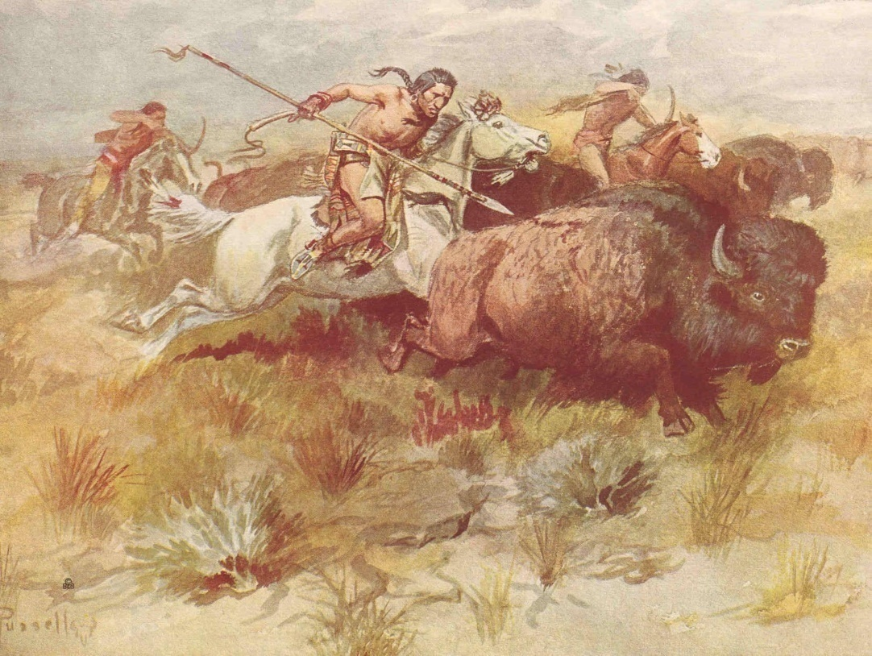
Free Rider Problem?

Slide 23
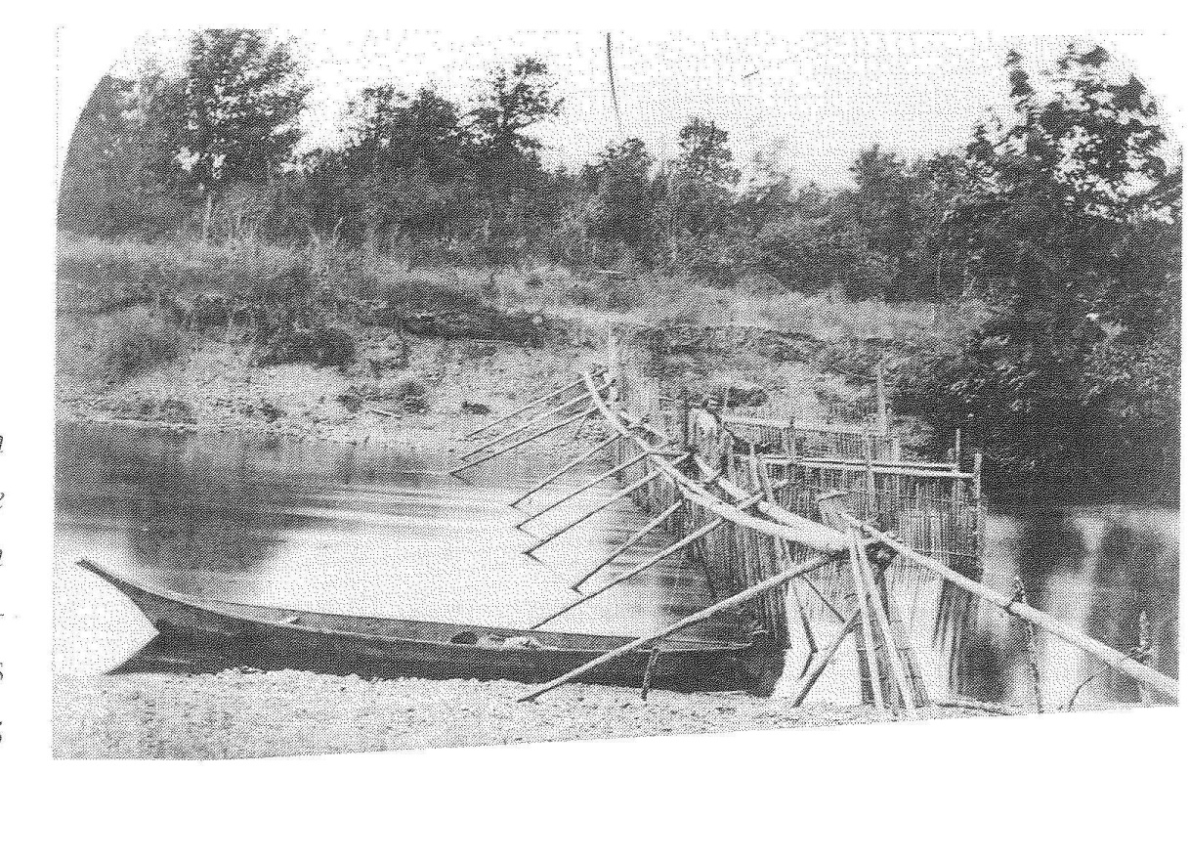
Secure Prop Rights for
Capital Investment
Notes:
Note sharp contrast with Jared Diamond’s book, Colapse

Slide 24
Whose Stream?
Notes:
Note sharp contrast with Jared Diamond’s book, Colapse

Slide 25
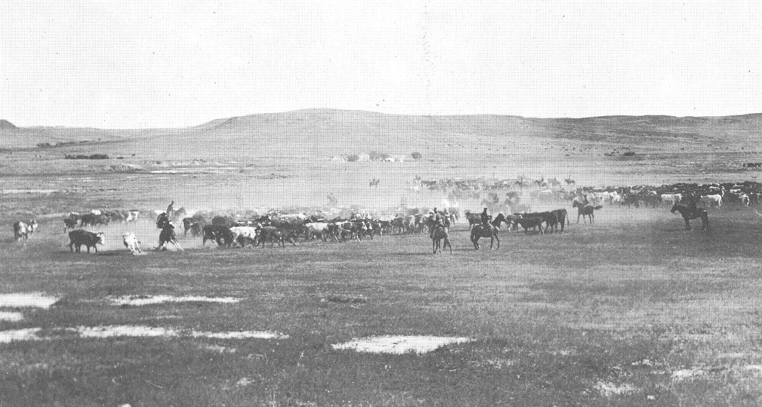
Producing Property Rights
Montana, Circa 1860

Slide 26
“You boys ever hear of the tragedy of the commons?”
MC’
$
M C
MB
C*
CTM
Cows

Slide 27
The NOT so
Common Commons
Custom, culture, and ideology
Formal property rights
Government regulation

Slide 28
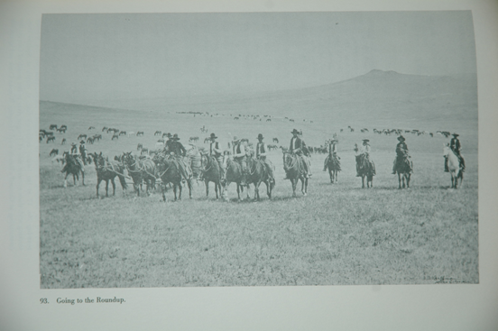
Cattlemen’s Associations

Slide 29
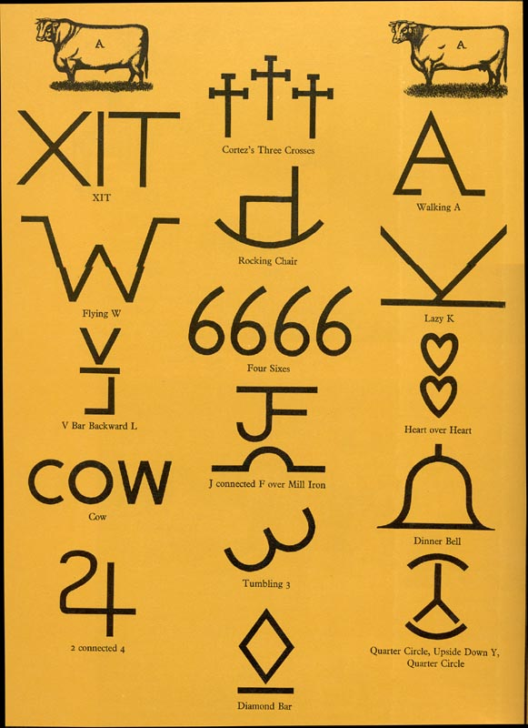
Roundups & Branding

Slide 30
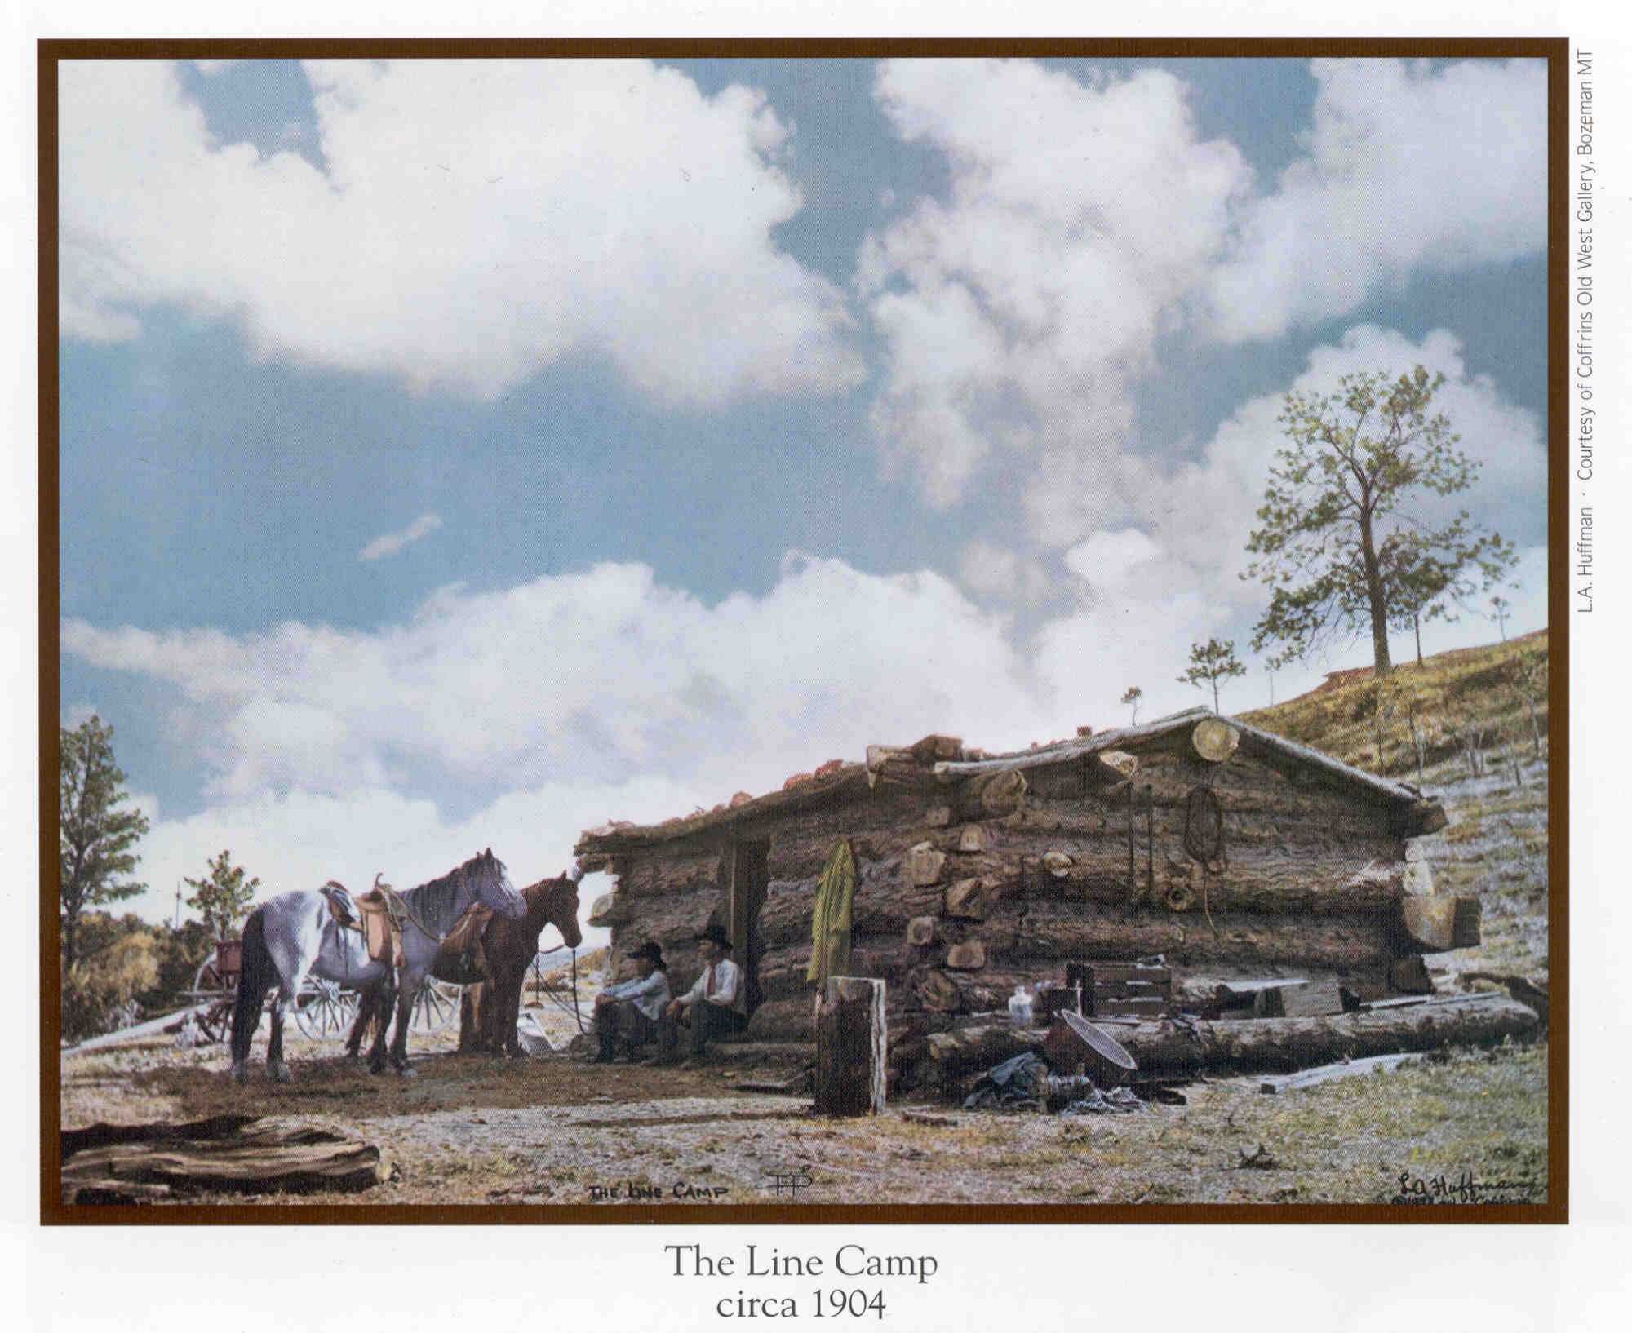
Human Fences:
Line Camps

Slide 31
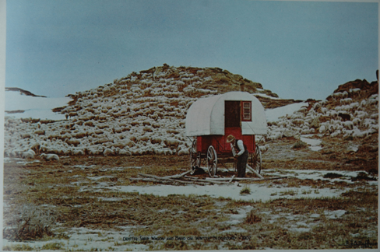
Why Range wars?
Who needs the roundup?

Slide 32
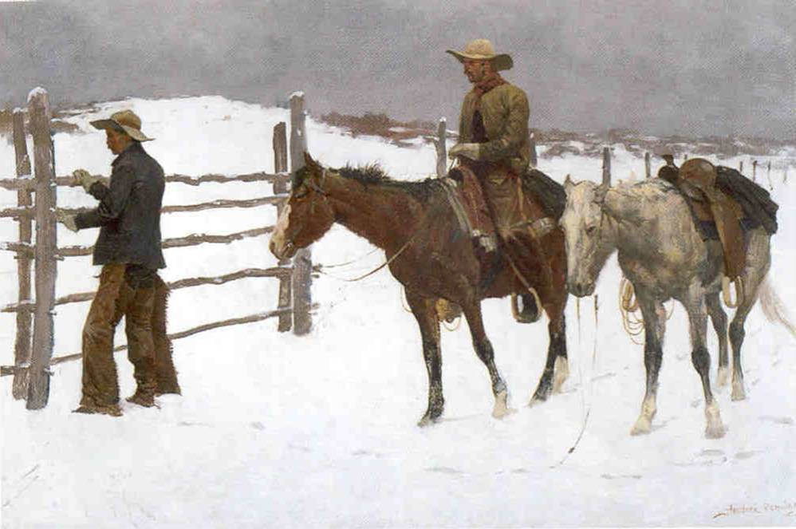
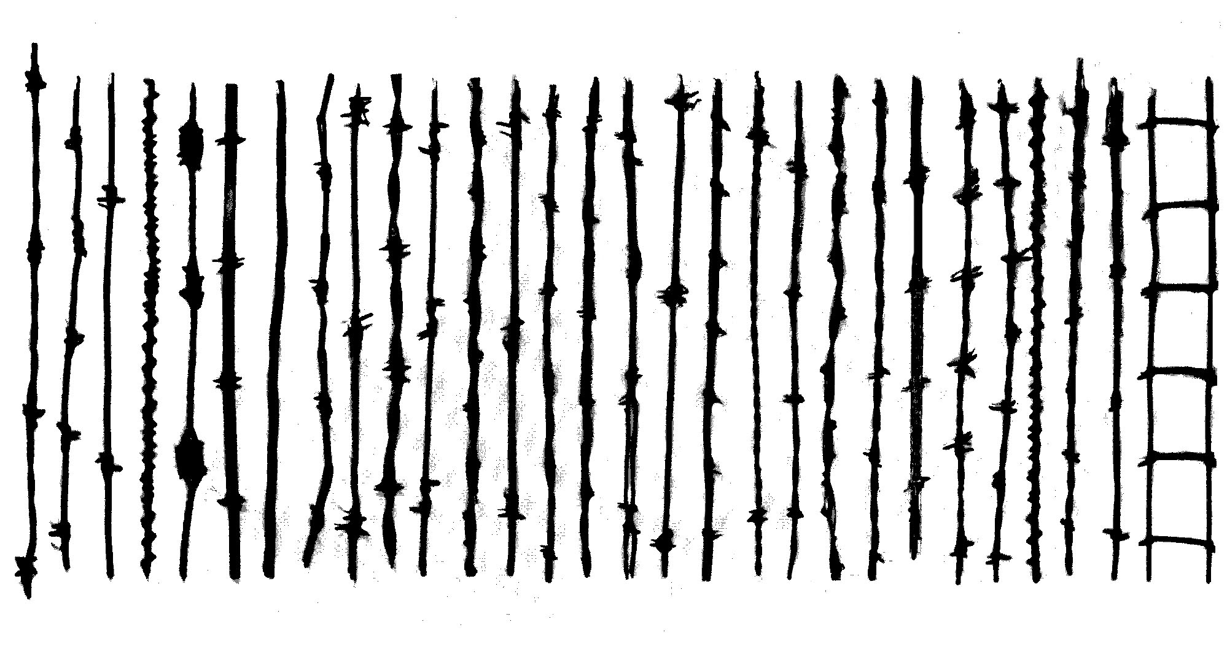
Technology of
Property Rights
Fall of the Cowboy
Price: 1874-$308/100 lbs
1897-$40/100 lbs

Slide 33
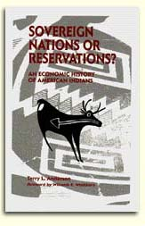
“I own this place.”
Weakening Property Rights

Slide 34

Producing Property Rights
in Bolivia
Bees and Barbed Wire for Water

Slide 35
BREAK

Slide 36
Free Market Environmentalism continued
Terry L. Anderson
Executive Director, PERC
Senior Fellow, Hoover Institution

Slide 37
PART III
The Regulation of Property Rights

Slide 38
Finding Property Rights through Government
Environmental problems are property rights problems
Who has what rights?
Settle or Litigate?
MB vs MC

Slide 39
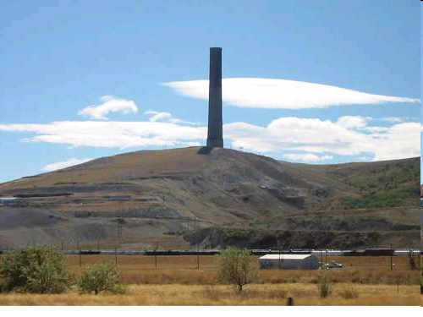
Who owns the gunk and who owns the dump?

Slide 40
Who owns the air?
Eng. & Mining Journal, 1893 “the unfortunate traveler from South Butte traces his way not by landmarks, for these are utterly invisible, but by the hacking cough of his forerunner, who though a few feet away is completely veiled in smoke.”
1899, District Judge ordered Butte smelters to take action to prevent their smoke from deluging the town or be enjoined from operating.
ACM moved smelter to Anaconda where clean air was less scarce.

Slide 41
Liability rule for air.
Months after opening new smelter in 1902, state condemned milk from local dairies blaming smoke from smelter.
ACM negotiated by reducing emissions and paying damages.
Ex post liability settlement

Slide 42
Property rule for land
1903, the ACM paid farmer $1,500 for an easement “to enter upon, use, and enjoy” his land for the “purpose of a dumping ground and for the deposit of slums, tailings and debris from the smelting plants and reduction works.”
Easement gave company the ability to float its tailings and debris down “the waters of warm springs creek and the waters of Deer Lodge River” onto the Beckstead property into perpetuity.
By 1912 ACM held 15 easements out of 20 ranches and was trying to secure easements for other 5.

Slide 43
Litigation over air continued.
Farmers formed an association.
Lack of settlement led to the longest and costliest injunction suit ever brought before an equity court in the U.S.
Why the difference between land/water and air?

Slide 44
Clarifying Expectations
Injunction sought by farmers denied, but damages would have to be paid.
ACM switches to smoke pollution easements.
Easement granted “in perpetuity, . . . .the right to emanate and issue into the atmosphere all smoke, fules [sic], and gases and the substances contained therein, which may issue or emanate from said smelters, mills, or other reduction works” across his property “and to pollute the atmosphere to the extent that the same may be polluted in connection with any such operations or acts” by the ACM.

Slide 45
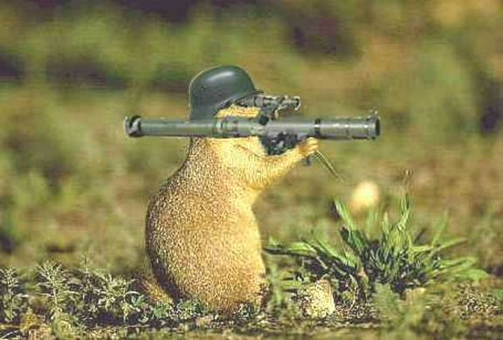
Mudding the Water:
Making the Environment the Enemy

Slide 46
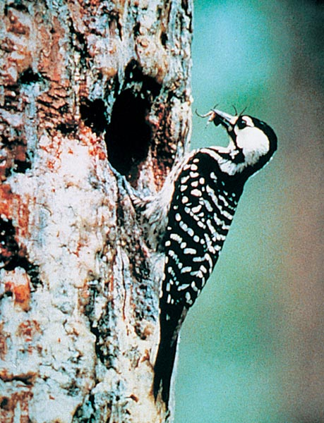
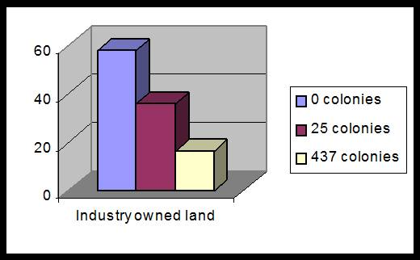
“ESA has turned old growth into pulpwood.”
RCW

Slide 47
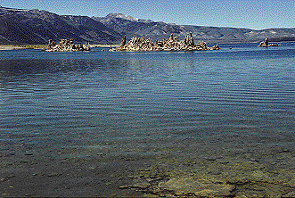
Mono Lake
1970s new demands for env. amentities
Over 20 years of court battles, lake’s level declined.
Public trust doctrine didn’t clarify rights and allow bargaining.

Slide 48
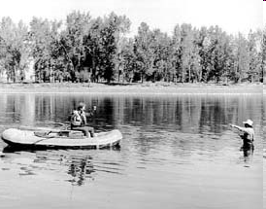
Who has Right to Access
Navigability or Public Trust
Stream Access laws in MT, UT, CO

Slide 49
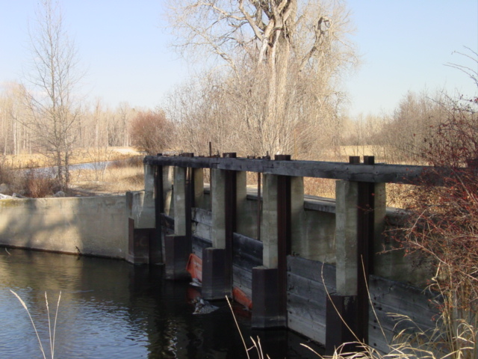
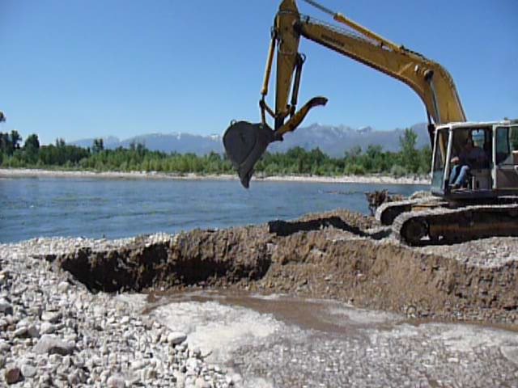
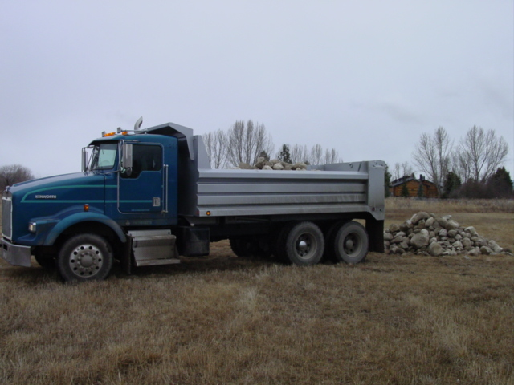
Is it a ditch?

Slide 50
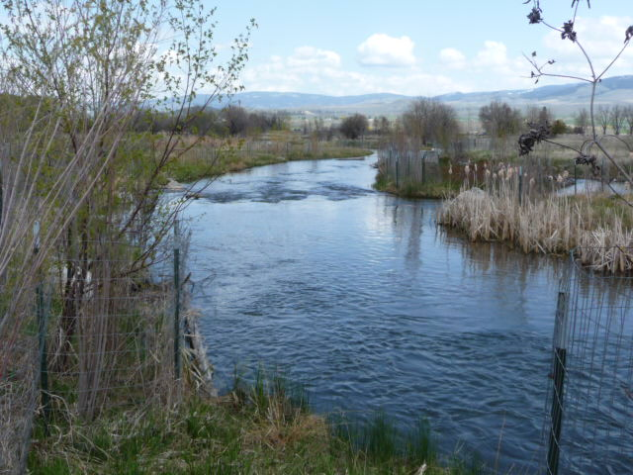
Or is it a slough?
“In western river valleys where irrigation has been a way of life for generations, the entire surface and subsurface hydrology is no longer ‘natural.’ But that does not mean the water in those systems is no longer public water.”

Slide 51
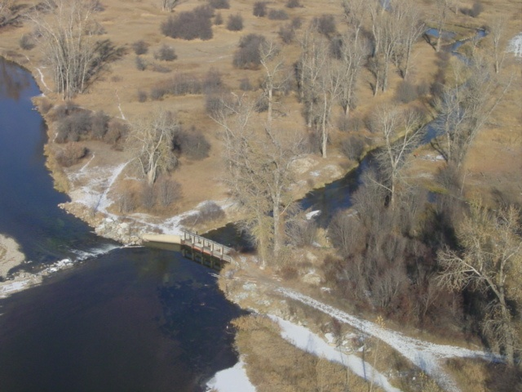
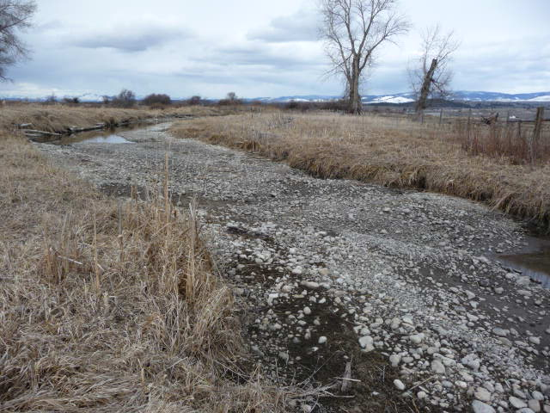
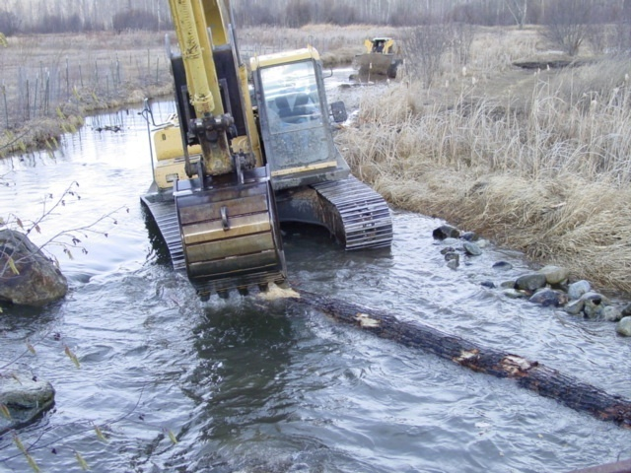
The Bad, the Good,
& the Ugly
“If you want to buy a big ranch and you want to have a river and you want privacy, don't buy in Montana.“ Gov. Schweitzer

Slide 52
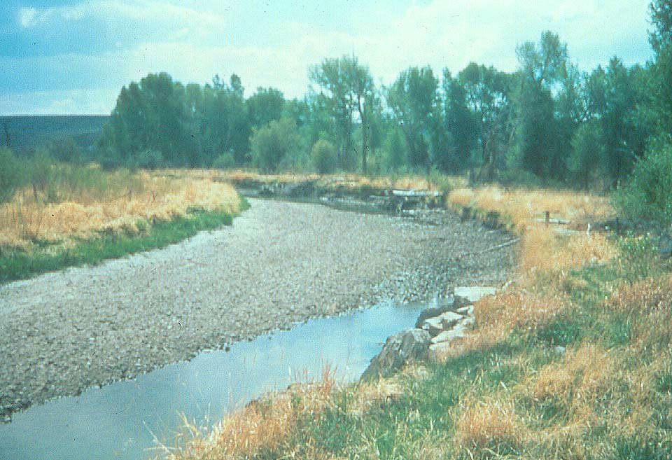
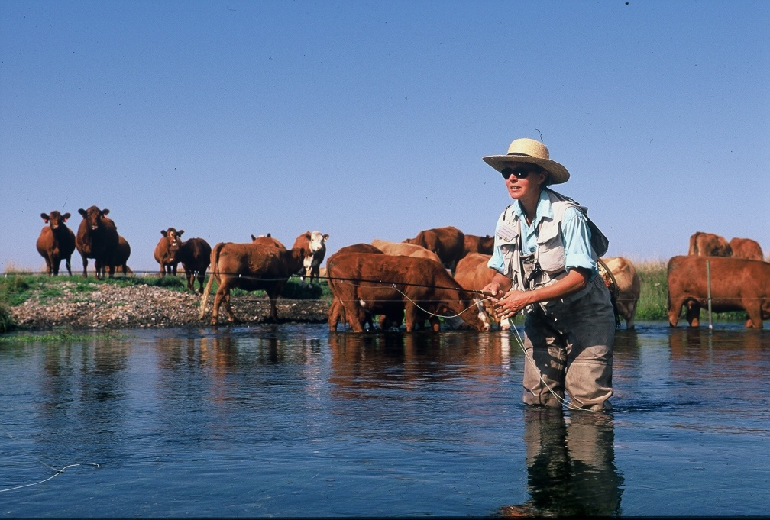

Buy that Fish a Drink:
Cows NOT Condos
1997 and 2007--$530 million to purchase 10 million acre-feet of in-stream flows
CO River Compact

Slide 53
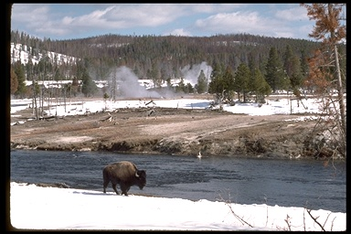
“Where buffalo roam and brucellosis flows.”

Slide 54
Missing Market:
What would Coase ask?
Who has what rights?
Who should pay whom?
  Should ranchers pay park to keep its bison in?
  Should the park pay the ranchers for damage to cattle?
  Should environmentalists pay to move cattle?
How can the entrepreneur create a market?

Slide 55
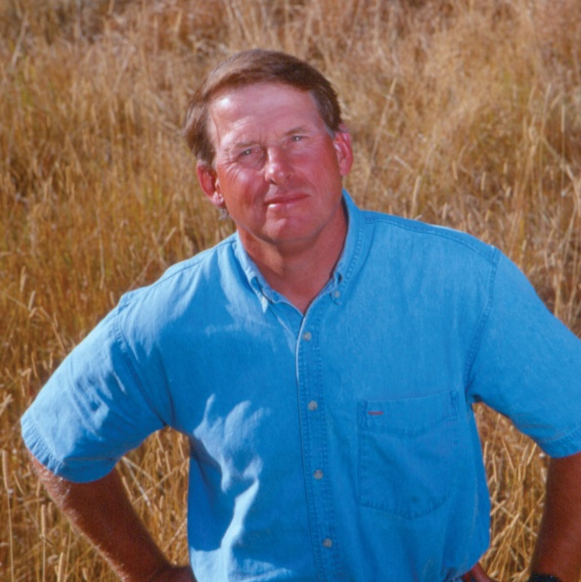
Accepting Property Rights and Making a Market
74,000 acre sheep grazing allotment
1999 and 2003, bears and wolves killed more than 100 sheep on the allotment
National Wildlife Federation will pay the ranchers $130,000
NWF purchased and retired the permit and found alternative grazing land.
"We aren't getting rid of grazing; we're redistributing where it occurs -- away from core wildlife areas near national parks and wilderness areas and closer to low-conflict areas." Hank Fischer

Slide 56
Property Rights through
Regulations: Cap-and-trade
Legislatures can create property rights.
Rights must be defined and enforceable.
If they work, they eliminate dead weight losses.
  SO2 markets
  ITQs

Slide 57
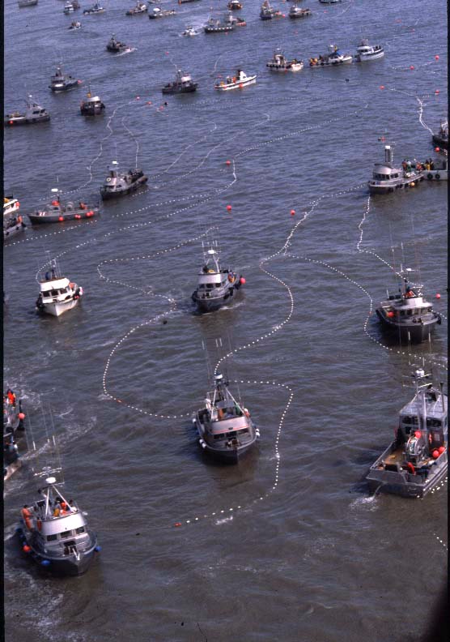
Derby Fishing
Notes:
Bristol Bay salmon fishery on opening.

Slide 58
Cap-and-Trade that works

Slide 59
Cap-and-Trade—Who Gets the Rents?
What is the scarce resource?
Who gets it?
  Auction
  Grandfathering
It is hard to give away rights hence RENT SEEKING

Slide 60
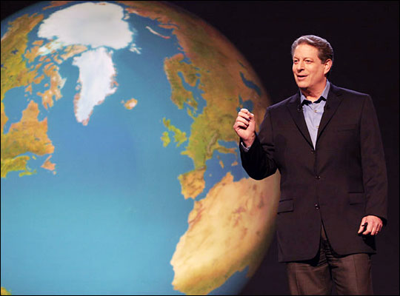
The Mother of them All

Slide 61
Carbon Credits
Cap-and-Trade that Won’t Work
Defining and enforcing cap is difficult
Allocating them is difficult.
  Sell them---$650 billion
  Give them away
  “If you’re not at the table, you’re on the menu.” Jeff Immelt, GE
Bootleggers and Baptists

Slide 62
Conclusion
Markets require creating well-defined, enforced, and tradeable property rights.
Tradeability gets the incentives right.
Property rights are produced--bottom up or top down.
Weak property rights cause conflict and misuse of resources.
Rent seeking weakens property rights.
The hardest problem is getting government to protect property rights and not weaken them.

Slide 63
PERC
Making Environmental Markets
2048 Analysis Drive, Ste. A
Bozeman, MT 59718
406-587-9591
www.perc.org
tla@perc.org

Slide 65
An Inconvenient Tax
What are the costs?
  1-3% of world output by 2030
  Lieberman-Warner $800-$1300/household by 2015
    $1500-$2500 by 2050
  Cost of 15% carbon reduction on after tax income
    Bottom quintile 3.3%
    2nd and 3rd quintiles 2.7 to 2.9%
    Top quintile 1.7%
Who are we trying to kid?

Slide 66
Bootleggers and Baptists
Protectionism is replacing environmentalism
  Energy Sec. Chu calls for “carbon tariffs” to “level the playing field.”
Again we must ask: At what cost?

Slide 68
Property Rights &
Rule of Law on Reservations
Mosaic of land tenure---fee simple, individual trust, and tribal trust
  Individual trust 30-40% less productive than fee simple
  Tribal trust 80-90% less productive than fee simple
    E.g. Crow coal reserves in 1988 = $26 billion, ROI = 0.01 percent

Slide 69
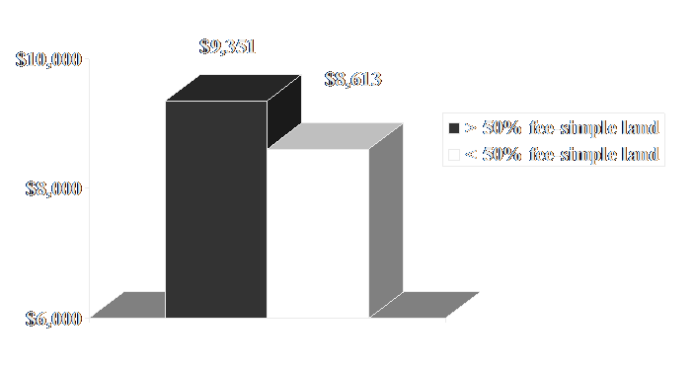
1999 Per-Capita Income of American Indians

Slide 70
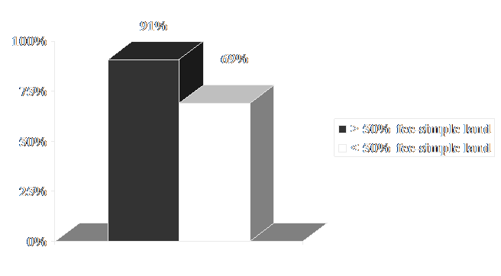
1969-1999 PCI Gr. Rates for American Indians

Slide 71
Property Rights &
Rule of Law on Reservations
Stable legal environment
Public Law 280
Approx. 30% of reservations with state jurisdiction

Slide 72
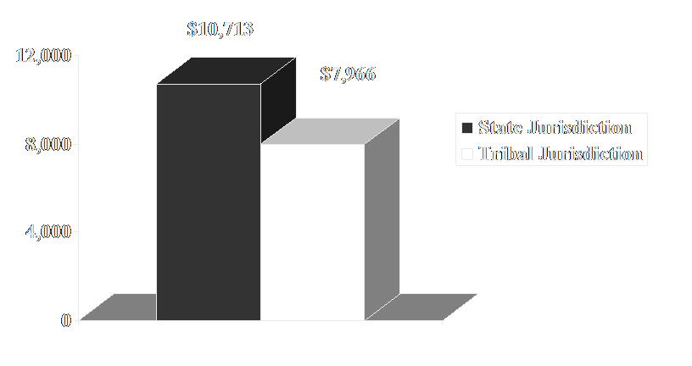
1999 Per-Capita Income of American Indians

Slide 73
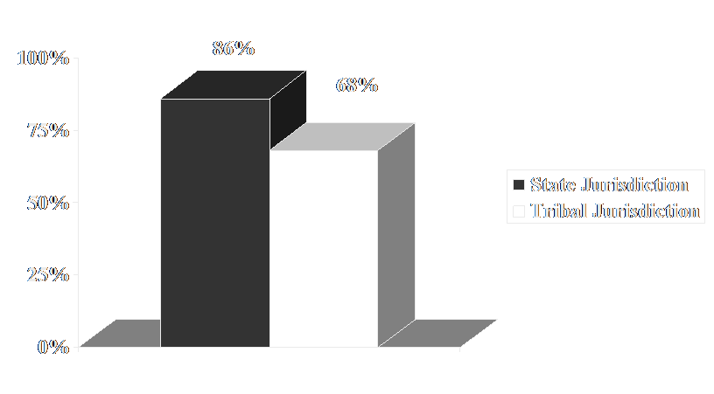
1969-1999 PCI Gr. Rates for American Indians

Slide 74
Kennerly v. District Court of Montana (U.S. Supreme Court 1971) & Security State Bank v. Pierre (Montana Supreme Court 1973)
Jurisdiction Matters
“A result of the Kennerly decision was to dry up credit sources throughout the state to responsible Indian citizens . . . .”

